Slide 1
Introduction to BDD in Python
PyLadies Workshop 2025-03-31

Slide 2
Agenda
Part 0: Setup
Clone the Repo and create virtual environment
Part I: What is BDD?
Introduction of Frameworks: BDD vs TDD vs TLD
Introduction of Given-When-Then Statements => Gherkin
Benefits and Common Pitfalls of BDD
Exercise 1: Introduction to Gherkin
Good vs. Bad Given-When-Then statements
Write Given-When-Then statements

Slide 3
Agenda
Part II: Frameworks
Overview over BDD frameworks in Python
Implementing Given-When-Then statements in Behave
Exercise 2:
Implement Given-When-Then statements in either Behave or pytest-bdd
Run tests and discuss output

Slide 4
Agenda
Part III: Practical Gherkin Features
Scenario Outlines
Tables
Parameterization
Backgrounds
Exercise: Advanced Syntax
Use Parameterization, Scenario Outlines, Data Tables and Backgrounds

Slide 5
The Goal of This Workshop
At the end of the workshop, you should be able to...
1. ... understand the benefits of BDD.
2. ... use BDD to specify the behaviour of your code in a structured way *before* writing it.
3. ... assert that your code exhibits the expected behaviour *while* writing it.
4. ... advocate for the use of BDD in your organisation should you chose to do so.

Slide 6
Part 0 - Setup

Slide 7
Setup
Go to the GitHub Repo for this project
Clone the repository with `git clone git@github.com:pyladiesams/bdd-with-python-mar2025.git`
Install the dependencies in your preferred way, example:
`python3.8 -m venv .venv`
`source .venv/bin/activate`
`pip install -r requirements.txt`
Verify that everything went well, by running:
`behave -qo test.txt solutions/features && rm test.txt`

Slide 8
Part I - What is BDD?

Slide 9
What is Behavior-Driven Development?
Evolved from Test-Driven Development (TDD)
Focuses on collaboration between devs, testers, and non-technical stakeholders
Describes system behavior in plain language
🧠 BDD = testing + collaboration + clarity

Slide 10
How is BDD Different?
Feature | TDD | ATDD | BDD
Written by | Developers | Devs + Testers | Devs + Testers + Biz
Format | Code (Unit Tests) | Natural Language | Natural Language
Focus | Code correctness (?) | Acceptance Criteria | Behavior (User Perspective)
Tooling | E.g. pytest | E.g. Cucumber, Behave | E.g. Cucumber, Behave

Slide 11
Alternative: Test-Last-Development
“Any idiot could implement a behaviour that's already designed and specified in detail by a clear, readable set of tests. I got into programming because I like a challenge, and there's no greater challenge than trying to write a function while simultaneously trying to work out what it should do.”
John Arundel for Bitfield Consulting

Slide 12
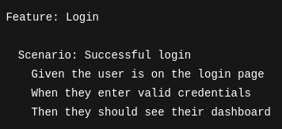
Gherkin: A Common Language
Plain-text, domain-specific language
Used by non-devs and devs alike
Keywords: Feature, Scenario, Given, When, Then

Slide 13
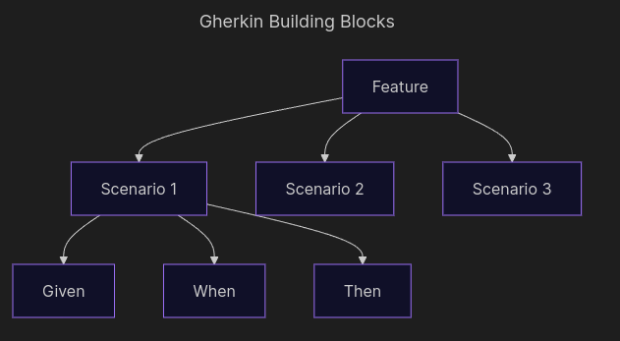
Building Blocks of Gherkin

Slide 14
Why Use BDD?
✅ Improves collaboration
✅ Clarifies expectations
✅ Produces living documentation
✅ Tests are readable by everyone
✅ Encourages focusing on value, not just implementation

Slide 15
Common Pitfalls in BDD
⚠️ Writing tests, not behavior
⚠️ Over-detailed steps ("click this button" vs "submit form")
⚠️ Not involving business stakeholders
⚠️ Duplicate or unmaintainable scenarios
⚠️ Using Gherkin for everything (not every test should be a feature test)

Slide 16
Exercise 1a: Good and Bad Gherkin

Slide 17

Notes:
❌ Why it's not ideal:
It focuses on implementation details ("click", "type") rather than business behavior.
“I” is used instead of a role like “the user,” which breaks the consistency of the domain language.
Step order is illogical — clicking the login button usually comes after typing credentials.

Slide 18

Notes:
✅ This is a good scenario
✅ Why it's good:
It's written from the user's perspective in business terms, not technical UI actions.
It describes the system behavior clearly and concisely.
It captures a valuable rule: unauthorized access redirects to login.

Slide 19

Notes:
What’s okay:
It describes a behavior that's meaningful to the user.
It’s relatively readable.
What could be improved:
“I open the app” is vague and not very useful as a precondition.
“I” should be replaced with “the user” to keep things consistent.
Could make it clearer what "search results show headphones" means — is it partial match? Sorted? etc. (if relevant).

Slide 20
Exercise 1b: Write your own Gherkin from Requirement Files
Notes:
ToDo: Add requirements file and example .feature file

Slide 21
Exercise 1b: Defining Scenarios with Gherkin
Open the workshop repository
Navigate to workshop/features/basket.feature. The file contains already a header as well as an example scenario to get you started, but feel free to delete the file, if you would like to start from scratch.
Try adding 2-4 new scenarios based on the requirements on the following slides

Slide 22
Your PM gives you the following requirements…
1. A logged in customer can add items to their basket.
2. A logged in customer should be able to see all items currently in their basket.
3. If the same item is added multiple times to the basket, the quantity of the item should increase instead of the item being duplicated.
4. The basket should show the total price for all items currently in it.
5. Customers can remove items from their basket.
6. Customers cannot add out of stock items to their basket.
7. If a customer is not logged in, their basket should still be stored temporarily.
8. If a customer with a temporary basket logs in, their temporary basket should merge with their user basket.

Slide 23
Part II: Frameworks

Slide 24
BDD Frameworks in Python
Framework | Description
Behave | Most widely used BDD tool in Python. Follows Cucumber style.
pytest-bdd | Integrates BDD into the pytest ecosystem.
Radish | More flexible, supports advanced Gherkin dialects.

Slide 25
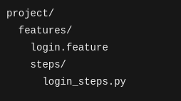
Behave: How It Works
.feature files define scenarios (written in Gherkin).
Step implementations live in Python modules.
“behave” command runs everything.

Slide 26
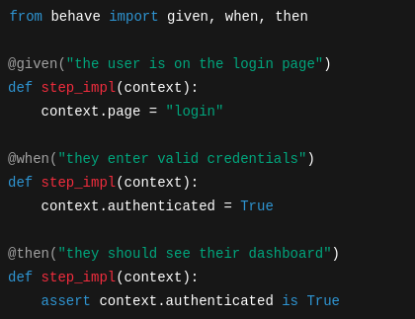
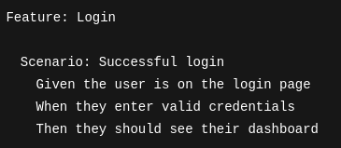
Implementing Steps in Behave

Slide 27
Implementing Steps in Behave

Slide 28
Implementing Steps in Python
🛠 Behave uses decorators like @given, @when, and @then.
🧠 Store shared state in the context object

Slide 29
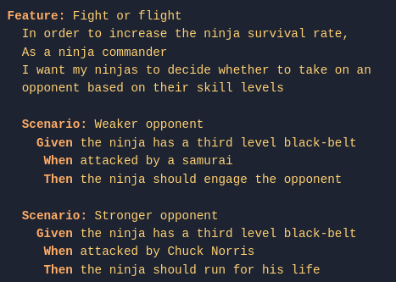
User Stories can be written into feature files
Feature and Scenario names show behave how to group tests together
Feature descriptions are only for the reader

Slide 30
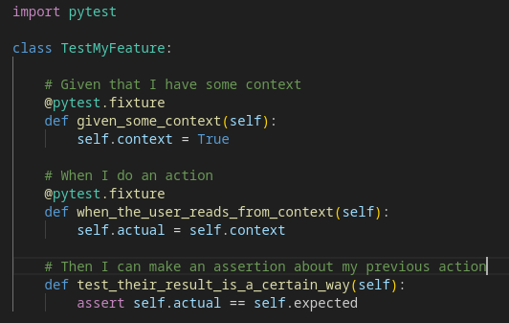
Do You Need a BDD Framework?
❌ No, you don’t strictly need one:
Then implement tests using standard tools like pytest.
Given/When steps could be represented with pytest fixtures.
Then steps could be normal assertions in test functions.

Slide 31
Do You Need a BDD Framework?
✅ But using a framework (like Behave) is beneficial:
Keeps feature files and step definitions tightly coupled.
Encourages focus on user behavior, not implementation details.
Makes scenarios easier to read, share, and maintain.
Prevents features and tests from diverging

Slide 32
Exercise 2: Implement Your First BDD Test

Slide 33
Exercise 2: Hands-On Implementation
Instructions:
Navigate to workshop/features/steps/basket_steps.py
The file contains already a few step implementations to get you started, but feel free to start from scratch.
Try to implement the steps for (some of) the scenarios you have written in Exercise 1b.
When you are ready, run “behave workshop/features/basket.feature”.
Iterate on the code in workshop/src/models.py, until your tests succeed

Slide 34
Part III: Practical Gherkin Features

Slide 35
From Functional Requirements to Scenarios
Real systems = multiple states, validations, and edge cases
Functional specs often describe business logic in if-then or table form
BDD helps us turn that into executable documentation

Slide 36
Example Requirement: Tiered Discounts
💬 "Apply different discounts depending on customer type and total purchase amount."
Customer Type | Total >= 100$ | Discount
Regular | No | 0%
Regular | Yes | 5%
VIP | No | 10%
VIP | Yes | 20%

Slide 37
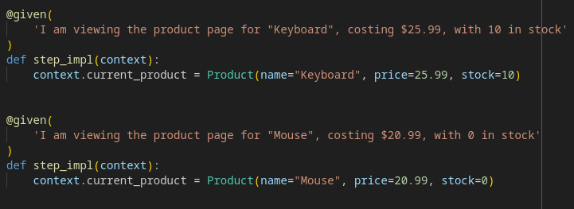
Parametrization of Steps

Slide 38
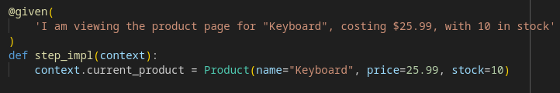
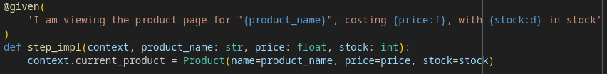
Parametrization of Steps
Note: Typehints are added for convenience and readability, they do not influence behave’s behaviour!

Slide 39
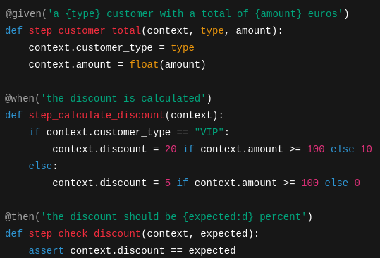
Step Definitions with Parameters
✅ Use placeholders like {amount} or {expected:d} for data injection

Slide 40
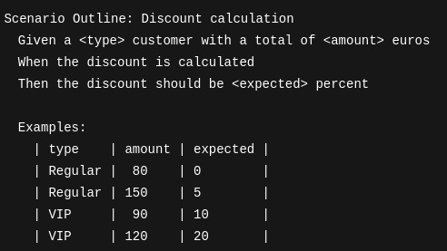
Parametrization of Scenarios -> Scenario Outlines

Slide 41
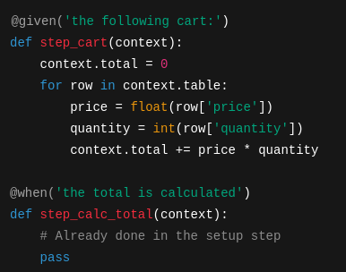
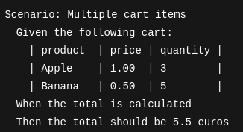
Alternative: Using Tables in regular Scenarios

Slide 42
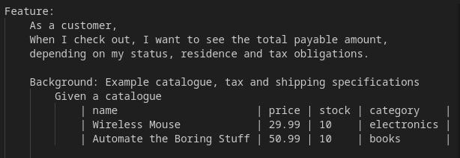
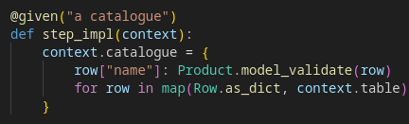
Backgrounds
Backgrounds are used to set up larger testing contexts, e.g. setting up browsers or databases
Backgrounds consist of Given Statements and And statements
Conceptually, they are Given statements that apply to all scenarios
The associated steps are implemented in the same way as other Given statements
Note: Execution is done for each associated Scenario individually!

Slide 43
Exercise 3: Advanced Syntax

Slide 44
Exercise 3: Advanced Syntax
Instructions (Easier):
Modify your step implementations from Exercise 2 to include:
Parametrization
Scenario Outlines
Background
Data Tables
Instructions (Harder):
Navigate to “workshop/features/checkout.feature”
Write a scenario outline based on the requirement in the file header. Make sure to use the Background Data provided.
Implement your Scenario Outline in “workshop/features/steps/checkout_steps.py”
Can you make the feature succeed?

Slide 45
Exercise Input: Order Fulfillment Rules
💬 “Orders can be placed only if the user is authenticated and all items are in stock. If an item is out of stock, the order should be rejected with a specific message.”
💬 “Shipping cost depends on region:
EU: €5 flat
US: €10 flat
Rest of world: €20”

